Slide 1
Theory of the P-N junction

Slide 2
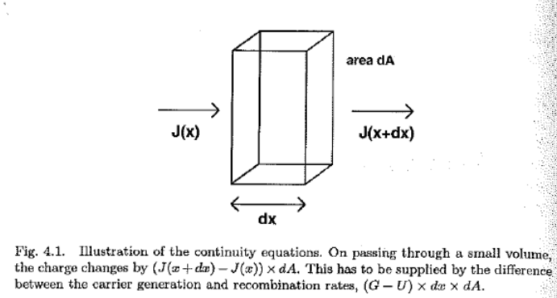
Generation and Recombination
4.1 Semiconductor transport equations

Slide 3
Continuity equation

Slide 4
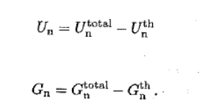
4.2 Generation & Recombination
Thermal Generation & Recombination

Slide 5
4.3 Transition Rates
4.3.1 fermi’s golden rule
Matrix element coupling initial and final states

Slide 6
Derivation of Fermi’s golden rule

Slide 8
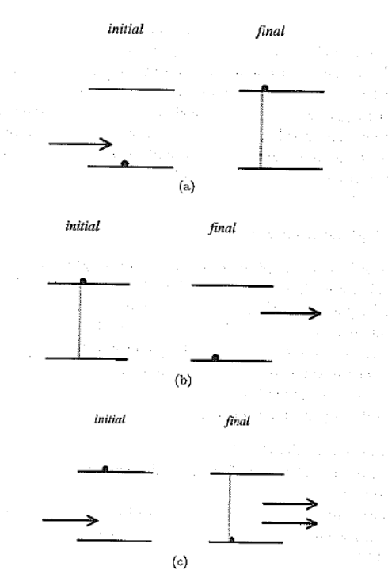
4.3.2 optical processes in a two level system

Slide 9
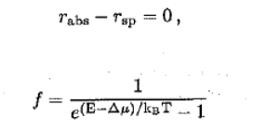
Steady state

Slide 10
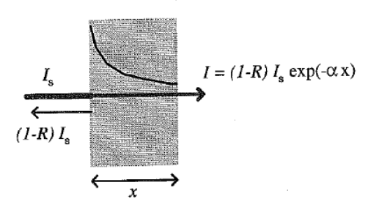
4.4 photon generation

Slide 11
4.4.3 microscopic description of absorption
Dipole approximation

Slide 13
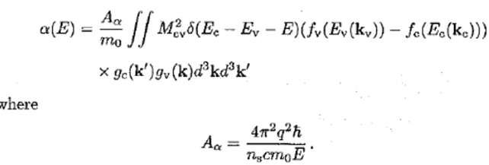

Slide 14
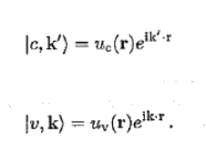
Direct gap

Slide 15
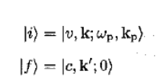
Indirect band gap

Slide 16
4.4.6 other types of behavior
Multiple step photon generation
Absorptions by excitons and sensitisers

Slide 17
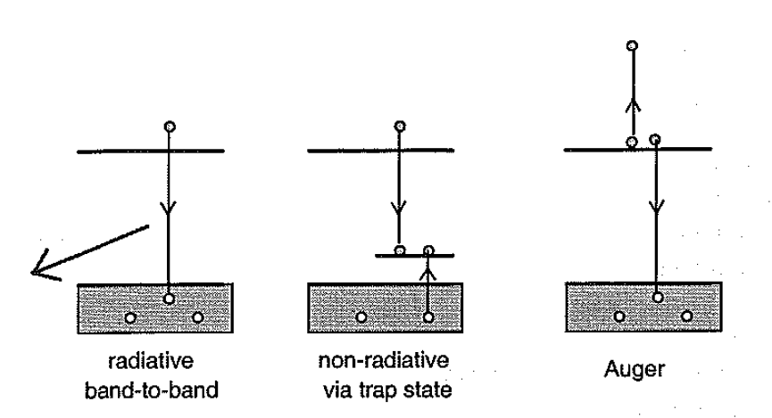
4.5 Recombination

Slide 18
4.5.2 Radiative recombination
Derivation of the radiative recombination rate
Intial state：
Final state：

Slide 19
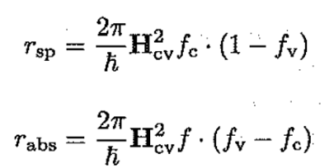
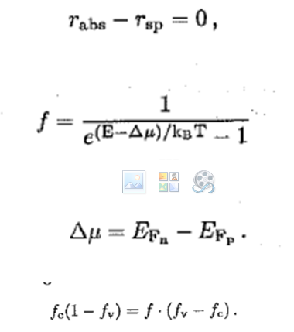

Slide 21
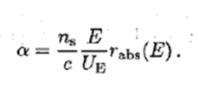
By last session’s conclusion
Substituting for

Slide 22
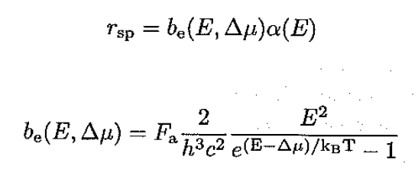
For application, interested in one direction, reduce to 1/4

Slide 24
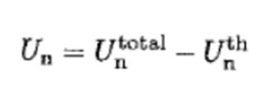

Slide 25
4.5.3 simplified expressions for radiative recombination
Carrier density independent and properties of the material

Slide 26
Degenerate semiconductor
Minority carrier radiative lifetime

Slide 27
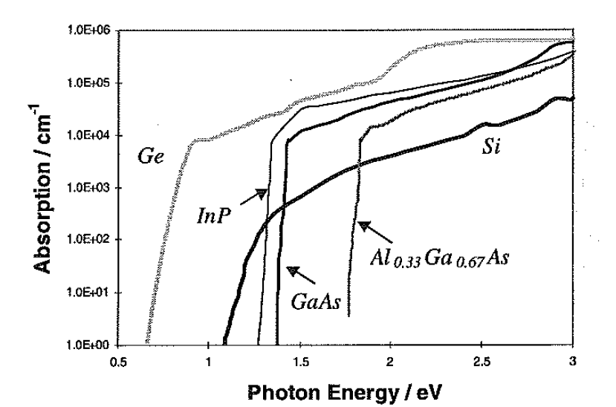
Larger for materials with a high absorption coefficient, and therefore radiative recombination
is more important
in direct bad gap
materials.
Relative to absorption, contributions from energy levels closer to the band edges are really important

Slide 28
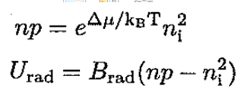
Radiative recombination from either band to impurity states inside the band gap can be very important, and can dominate over band-to band events.
When =qV

Slide 29
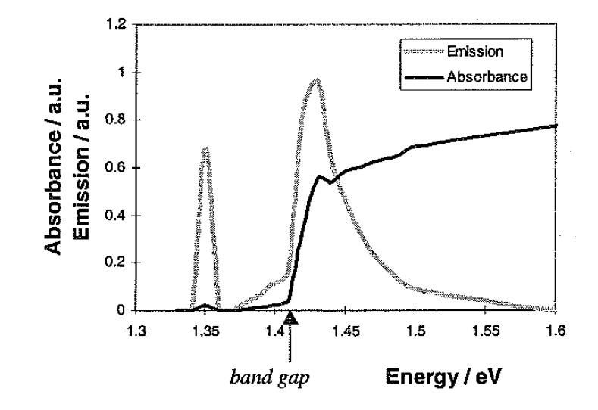

Slide 30
4.3 bimolecular recombination

Slide 31
MULTI-STEP PROCESS?
Relaships between rates and carrier densities?

Slide 32
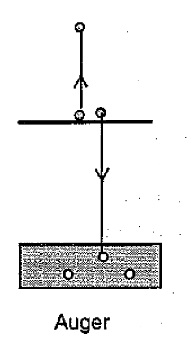
Three carrier –process : Auger recombination

Slide 34
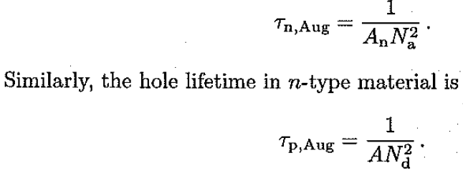
Lifetime for Auger recombination
In p-type material

Slide 35
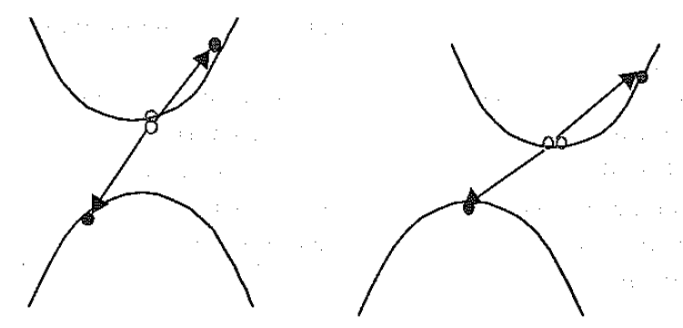
Momentum concervation

Slide 36
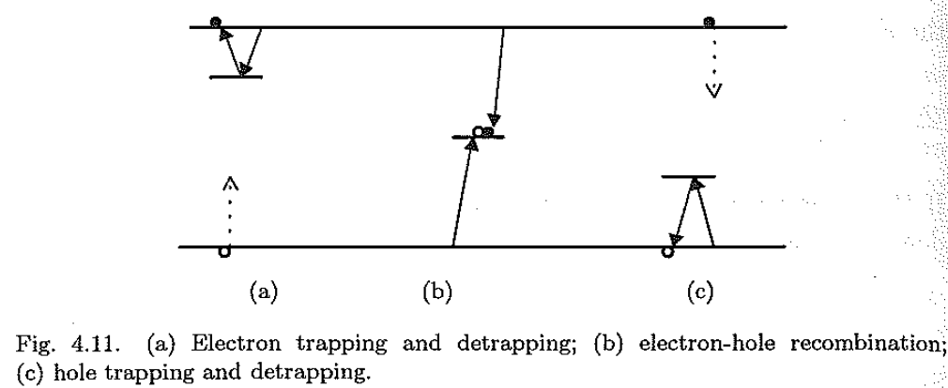
Shockley Read Hall recombination

Slide 37
Derivation of SRH recombination rate

Slide 39
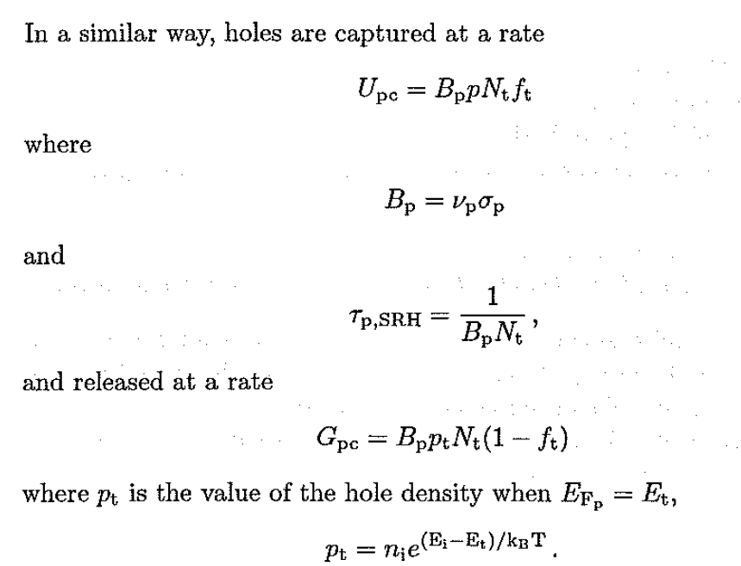

Slide 41
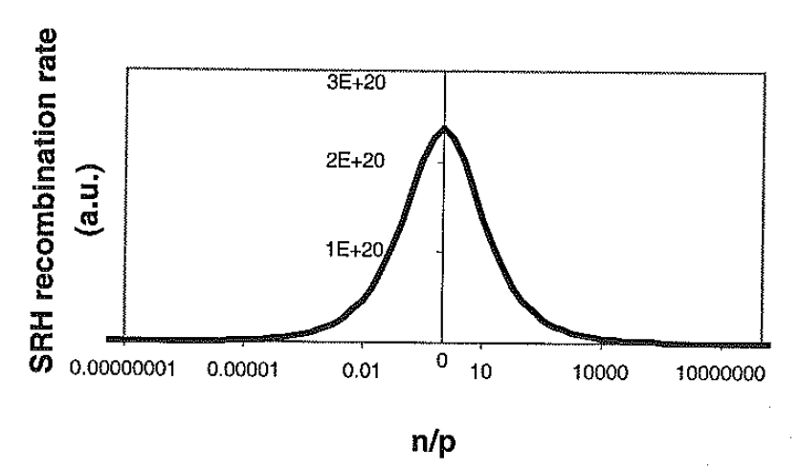

Slide 42
Surface and grain boundary Recombination

Slide 45
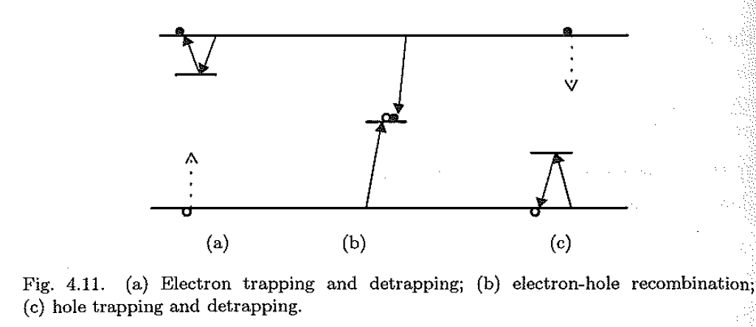
Traps vs recombination centers

Slide 46
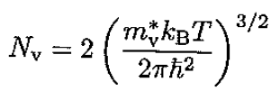
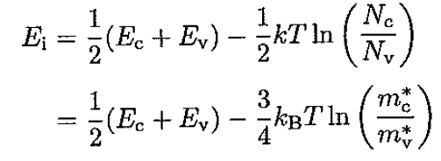
Chapter 3 Electrons& Holes

Slide 47
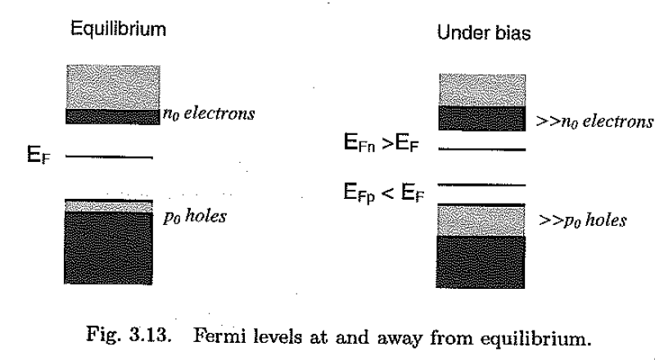
Quasi thermal equilibrium

Slide 48
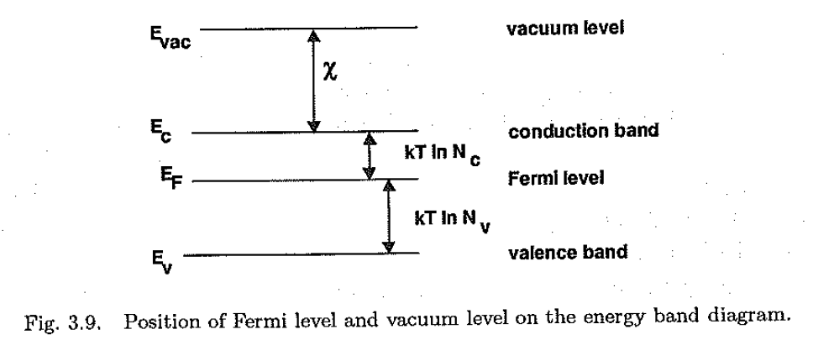
Current densities under bias

Slide 50
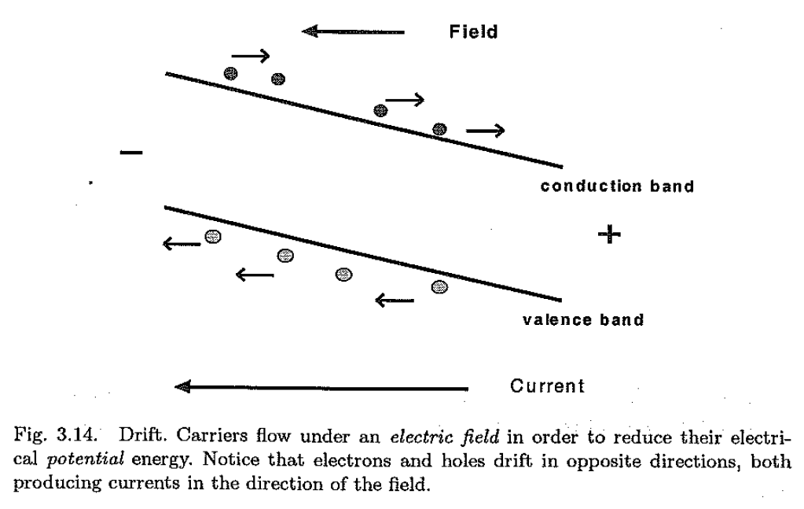

Slide 51
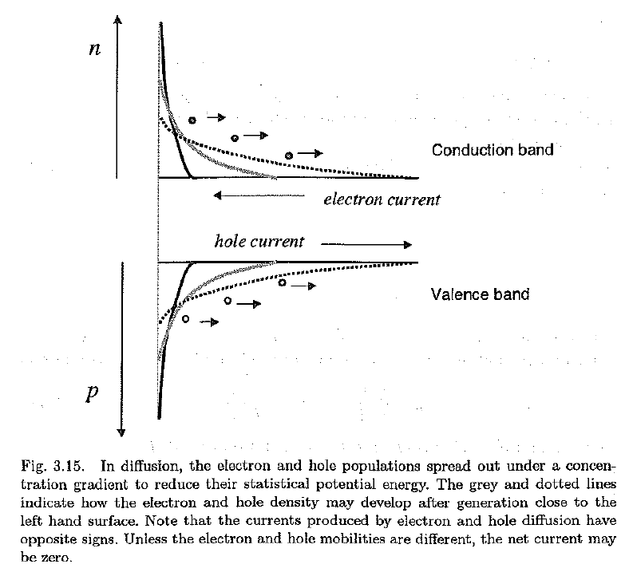

Slide 52
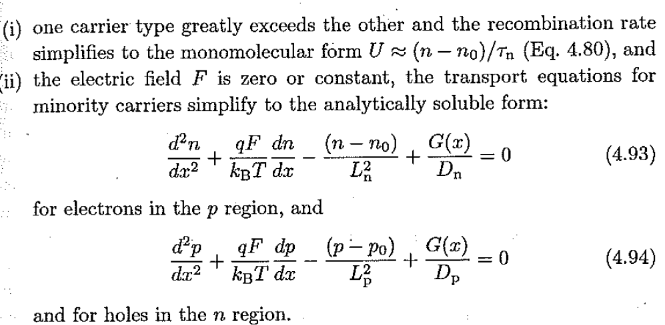

Slide 54
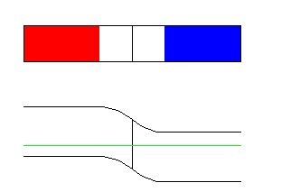
P-n junction
http://www.acsu.buffalo.edu/~wie/applet/pnformation/pnformation.html

Slide 56
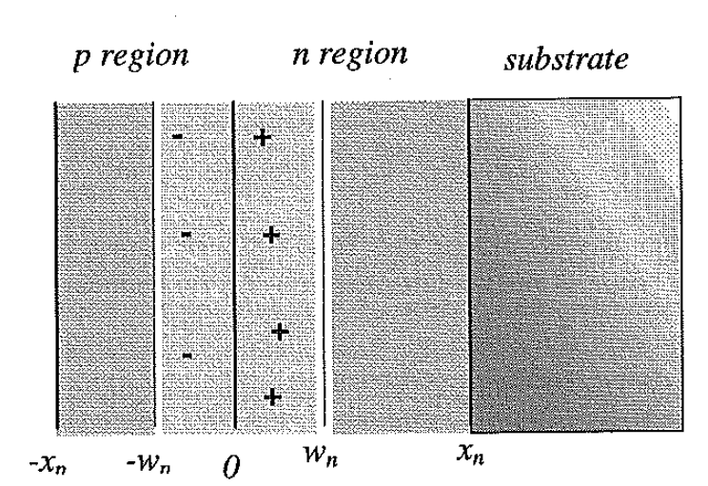
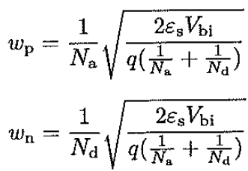
Depletion region

Slide 57
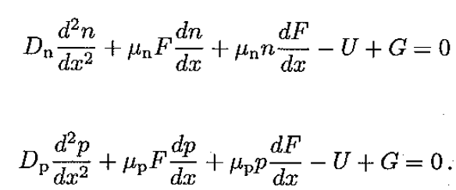
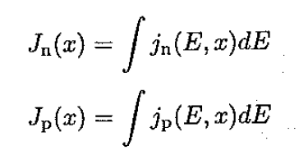
6.4 carrier and current densities

Slide 58
B.C:boundary condition

Slide 59
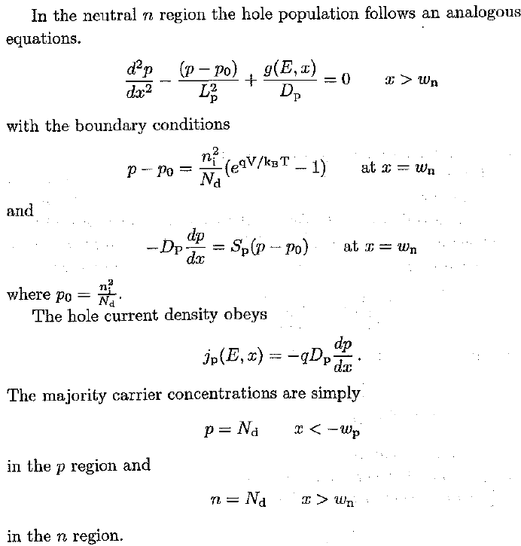

Slide 61
Currents and carrier density in the SPACE CHARGE REGION

Slide 62
TOTAL CURRENT DENSITY

Slide 63
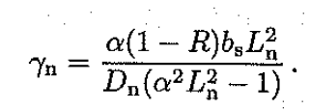
General solution

Slide 64
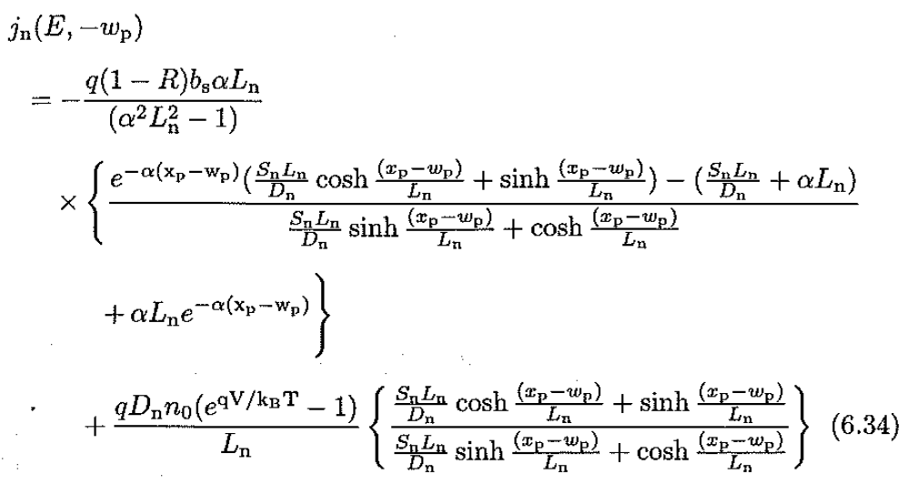
Jn

Slide 65
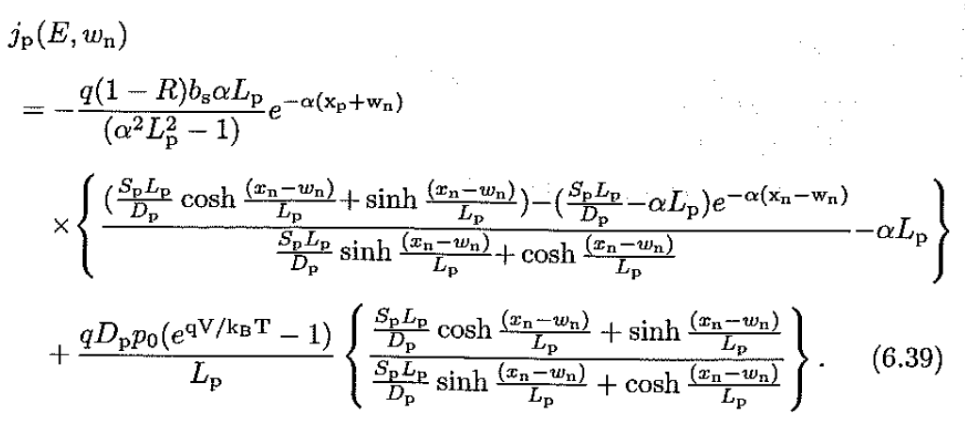
Jp

Slide 66
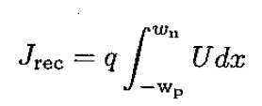
Jscr

Slide 67
P-N JUNCTION
DARK
UNDER ILLUMINATION
characteristics

Slide 68
Dark
Equilibrium 0
Under applied bias

Slide 69
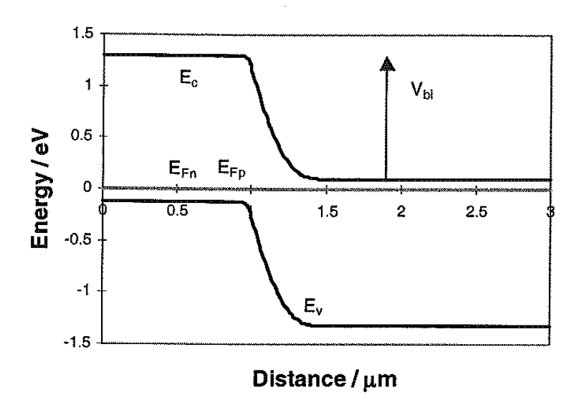
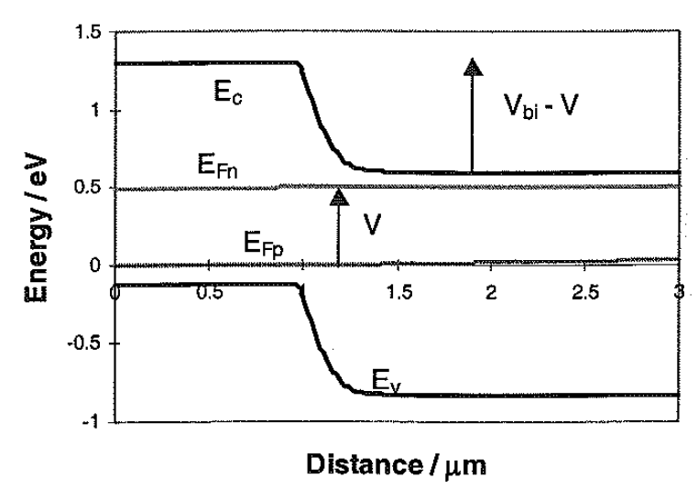
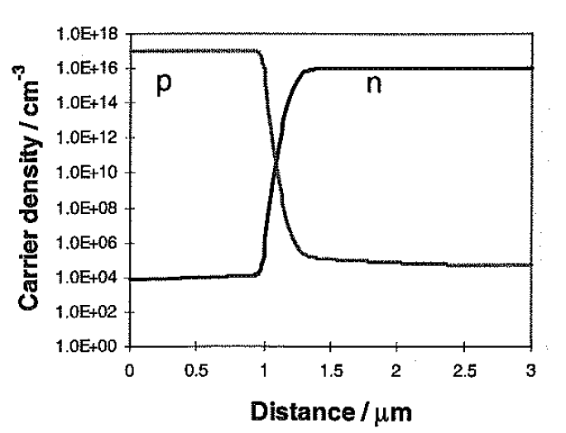
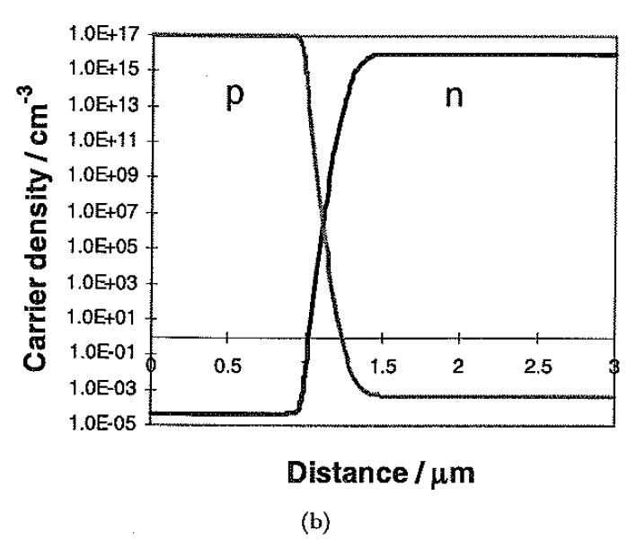

Slide 70
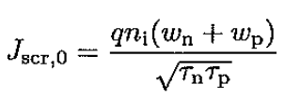

Slide 72
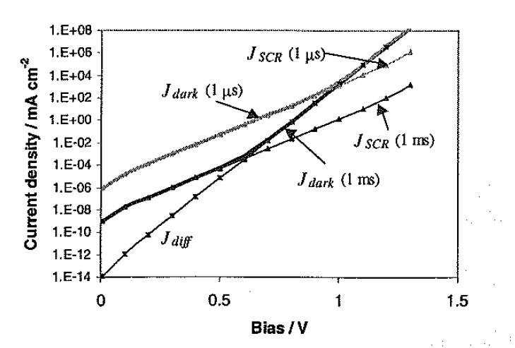

Slide 73
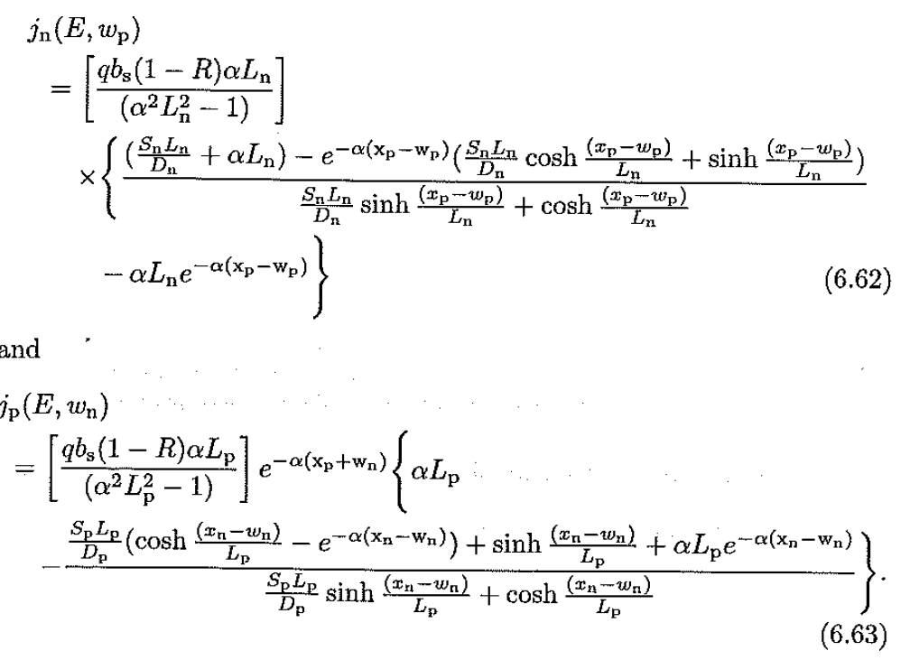
Under Illumination
Short circuit V=0

Slide 74
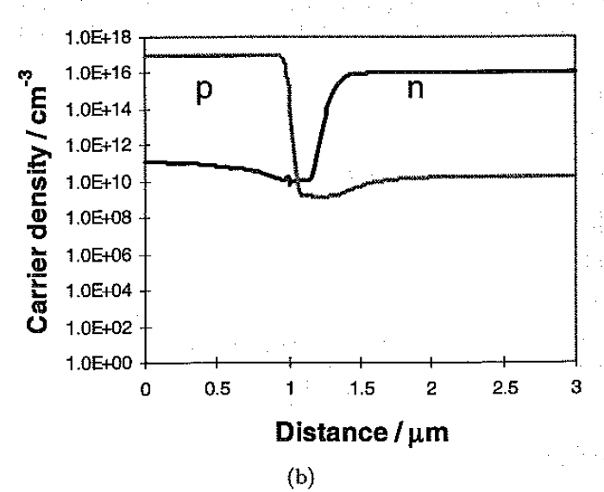
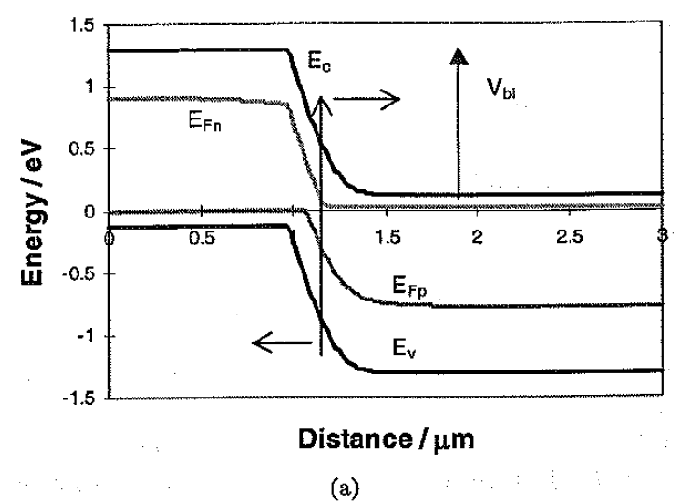

Slide 75
QE in special cases
Thick-neutral layers are much thicker than diffusion length

Slide 76
If Sn=Sp=0 q times the flux of photons absorbed that layer

Slide 81
P-n junction as a photovoltaic cell

Slide 83
Effects on p-n junction Characteristics

